Slide 1

Chapter -2
Made by Lecturer Navraj Koirala, CCT College, Butwal

Slide 2
Software Specification
A software requirements specification (SRS) is a description of a software system to be developed. It lays out functional and non-functional requirements, and may include a set of use cases that describe user interactions that the software must provide.
Software requirements specification establishes the basis for an agreement between customers and contractors or suppliers on what the software product is to do as well as what it is not expected to do. Software requirements specification permits a rigorous assessment of requirements before design can begin and reduces later redesign. It should also provide a realistic basis for estimating product costs, risks, and schedules. Used appropriately, software requirements specifications can help prevent software project failure.
Made by Lecturer Navraj Koirala, CCT College, Butwal

Slide 3
Software Specification contd.
The software requirements specification document enlists enough and necessary requirements that are required for the project development. To derive the requirements, the developer needs to have clear and thorough understanding of the products to be developed or being developed. This is achieved and refined with detailed and continuous communications with the project team and customer till the completion of the software.
Made by Lecturer Navraj Koirala, CCT College, Butwal

Slide 4
Uses of specification
1) A Statement of user requirements:-
  major failures occur because of misunderstandings between the producer and the user
  "The hardest single part of building a software system is deciding precisely what to build" (F. Brooks)
Made by Lecturer Navraj Koirala, CCT College, Butwal

Slide 5
Uses of specification (cont.)
2) Statement of the interface between the machine and the controlled environment:-
  serious undesirable effects can result due to misunderstandings between software engineers and domain experts about the phenomena affecting the control function to be implemented by software.
  It is therefore necessary to specify the interface between the machine and the controlled environment by describing precisely inputs, outputs, and expected relationships, including perhaps a specification of time constraints that the controller should satisfy.
Made by Lecturer Navraj Koirala, CCT College, Butwal

Slide 6
Uses of specification (cont.)
3) A Statement of requirements for implementation:-
  design process is a chain of specification (i.e., definition)–implementation–verification steps
    requirements specification refers to definition of external behavior
      design specification must be verified against it
    design specification refers to definition of the software architecture
      code must be verified against it
Made by Lecturer Navraj Koirala, CCT College, Butwal

Slide 7
Uses of specification (cont.)
4) A reference point during maintenance:-
  corrective maintenance only changes implementation
  adaptive and perfective maintenance occur because of requirements changes
    requirements specification must change accordingly
Made by Lecturer Navraj Koirala, CCT College, Butwal

Slide 8
Specification qualities
Precise, clear, unambiguous
Consistent
Complete
  internal completeness:-
  external completeness:-
Incremental
Made by Lecturer Navraj Koirala, CCT College, Butwal

Slide 9
Clear, unambiguous, understandable
Example: specification fragment for a word-processor
Selecting is the process of designating
areas of the document that you want to
work on. Most editing and formatting
actions require two steps: first you
select what you want to work on,
such as text or graphics; then you
initiate the appropriate action.
Made by Lecturer Navraj Koirala, CCT College, Butwal

Slide 10
Precise, unambiguous, clear
Another example (from a real safety-critical system)
The message must be triplicated. The three
copies must be forwarded through three
different physical channels. The receiver
accepts the message on the basis of a
two-out-of-three voting policy.
Made by Lecturer Navraj Koirala, CCT College, Butwal

Slide 11
Consistent
Example: specification fragment for a word-processor
The whole text should be kept in lines
of equal length. The length is specified
by the user. Unless the user gives an
explicit hyphenation command,
a carriage return should occur only
at the end of a word.
Made by Lecturer Navraj Koirala, CCT College, Butwal

Slide 12
Complete
Internal completeness
  the specification must define any new concept or terminology that it uses
    glossary helpful for this purpose
    External completeness:
  the specification must document all the needed requirements
    difficulty: when should one stop?
Made by Lecturer Navraj Koirala, CCT College, Butwal

Slide 13
Incremental
Referring to the specification process
  start from a sketchy document and progressively add details
Referring to the specification document
  document is structured and can be understood in increments
Made by Lecturer Navraj Koirala, CCT College, Butwal

Slide 14
Classification of specification styles
Informal, semi-formal, formal
Operational
  Behavior specification in terms of some abstract machine
Descriptive
  Behavior described in terms of properties
Made by Lecturer Navraj Koirala, CCT College, Butwal

Slide 15
How to verify a specification?
“Observe” dynamic behavior of specified system (simulation, prototyping, “testing” specs)
Analyze properties of the specified system
Analogy with traditional engineering
  physical model of a bridge
  mathematical model of a bridge
Made by Lecturer Navraj Koirala, CCT College, Butwal

Slide 16
Types of specification:-
Operational Specification.
Descriptive Specifications.
Made by Lecturer Navraj Koirala, CCT College, Butwal

Slide 17
1) Operational Specification
Operational Specification are those specification which describe the intended system describing the desire behavior usually by providing a model implementation of the system (that is abstract device that in some way can simulate its behavior.) Normally there are following types of operational specification:-
DFD
UML(Uniform Modeling Language)
c) Finite State machine(FSM
Made by Lecturer Navraj Koirala, CCT College, Butwal

Slide 18
a) Data Flow Diagrams: Specifying Functions of information system
Data flow diagrams(DFDs) are a well-known and widely used notation for specifying the functions of an information system and how data flow from functions to functions.
They describe systems as collections of functions that manipulate data.
Data can be organized in several ways: They can be stored in data repositories, they can flow in data flows, and they can be transferred to or from the external environment.
Made by Lecturer Navraj Koirala, CCT College, Butwal

Slide 19
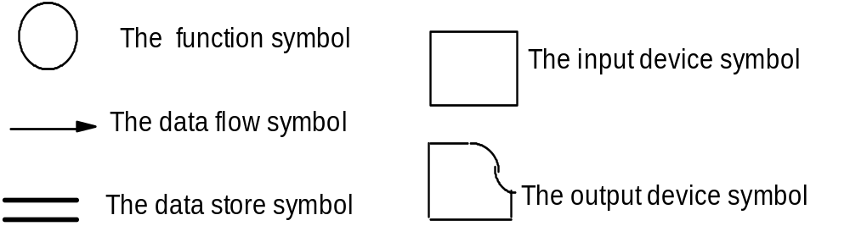
Basic elements of a DFD:
  bubbles represent functions
  arrows represent data flows
  open boxes represent data store
  closed boxes represent I/O interaction
Made by Lecturer Navraj Koirala, CCT College, Butwal

Slide 20
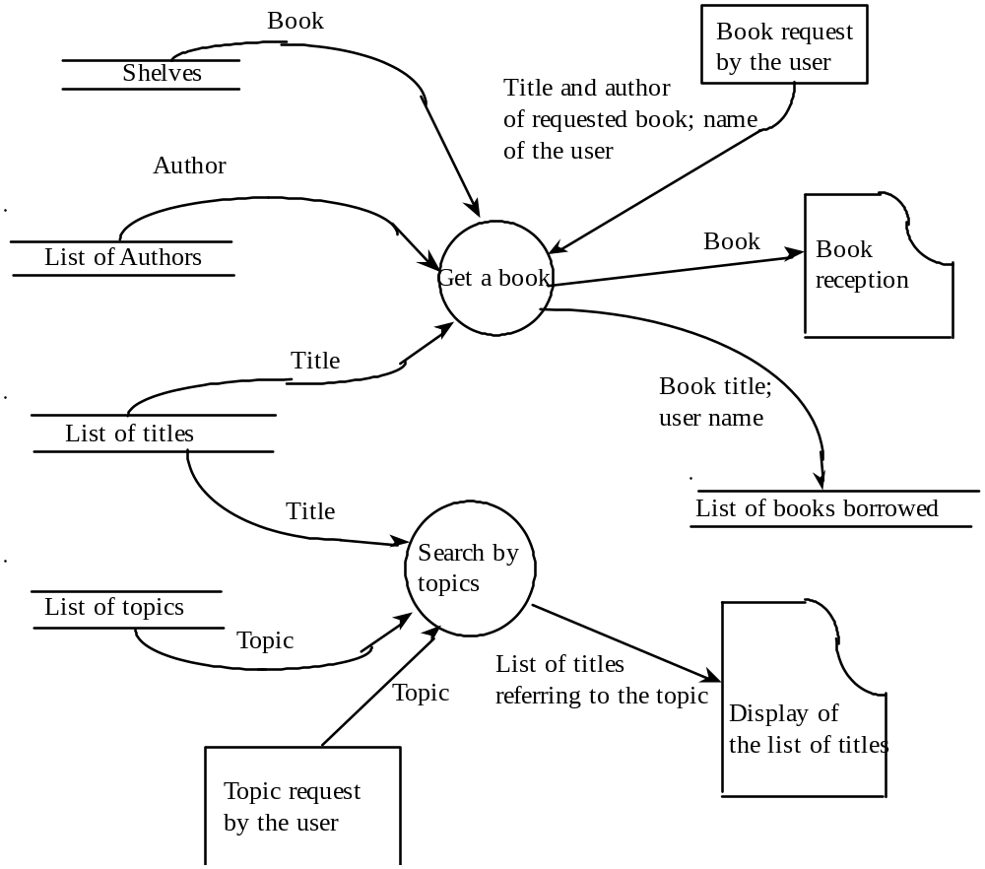
A DFD describing a simplified library information system
Made by Lecturer Navraj Koirala, CCT College, Butwal

Slide 21
b) UML diagrams for specifying Behaviors
UML is a collection of languages that provide specific notations to specify, analyze, visualize, construct, and document the artifacts of a software system.
The different UML diagrams are: use case diagrams, sequence diagrams, and collaborations diagrams.
Use case diagrams provide a global view of the actors involved in a system and the actions that the system performs, which in turn provide an observable result that is value to the actors. Use case diagrams describe the overall context of a system by partitioning the system’s functionality into transactions that are useful to actors and showing how actors interact with them.
Sequence diagrams and collaboration diagrams are two equivalent notations that can be used to describe how objects interact by exchanging messages. They provide a dynamic view of a system by graphically displaying scenarios that may occur at run time when objects interact to accomplish certain tasks.
Made by Lecturer Navraj Koirala, CCT College, Butwal

Slide 22
Use case diagram of library system
borrow
book
return
book
librarian
customer
library
update
Made by Lecturer Navraj Koirala, CCT College, Butwal

Slide 23
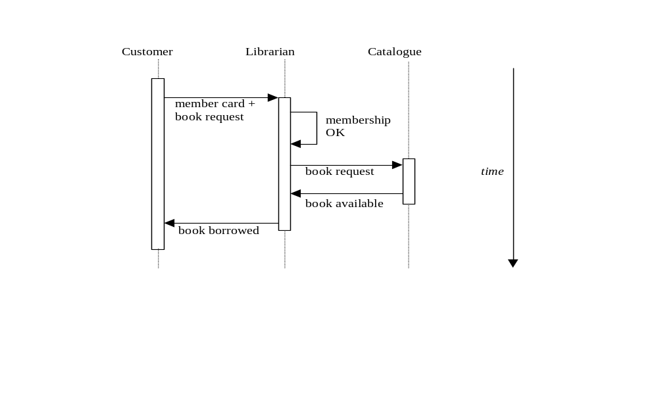
UML sequence diagrams of library system
Made by Lecturer Navraj Koirala, CCT College, Butwal

Slide 24
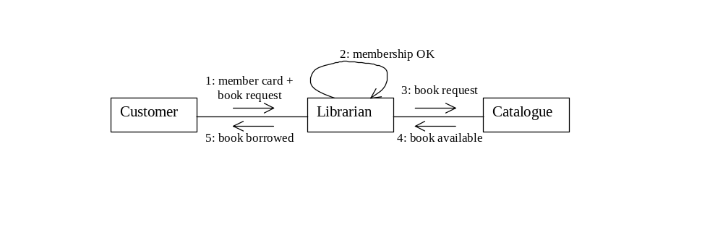
UML collaboration diagrams of library system
Made by Lecturer Navraj Koirala, CCT College, Butwal

Slide 25
Finite state machines (FSMs)
FSMSs are a simple, widely known, and important formal notation for describing control aspects.
An FSM consists of:
1. a finite set of states, Q;
2. a finite set of inputs, I;
3. a transition function d : Q x I → Q
(d can be a partial function)
Made by Lecturer Navraj Koirala, CCT College, Butwal

Slide 26
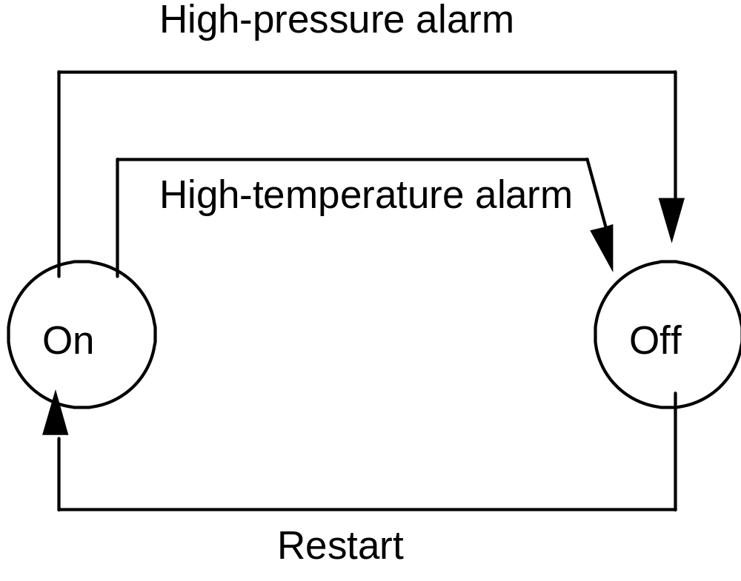
A finite state machine description of a chemical plant:
Made by Lecturer Navraj Koirala, CCT College, Butwal

Slide 27
2) Descriptive Specification:
Descriptive Specification try to describe the desired properties of a system rather than its desired behavior.
Types of Descriptive Specification :
Entity-relationship Diagrams:
It is a widely known and adopted notation for describing the relations among the data of an information system.
The ER model was motivated by the need for a conceptual model of data suitable for specifying user views and logical requirements in information system.
The model is based on three primitive concepts: entities, relations, and attributes.
The model has an associated graphical language, which is particularly easy to understand; the descriptions given in the graphical language are called ER diagrams.
Made by Lecturer Navraj Koirala, CCT College, Butwal

Slide 28
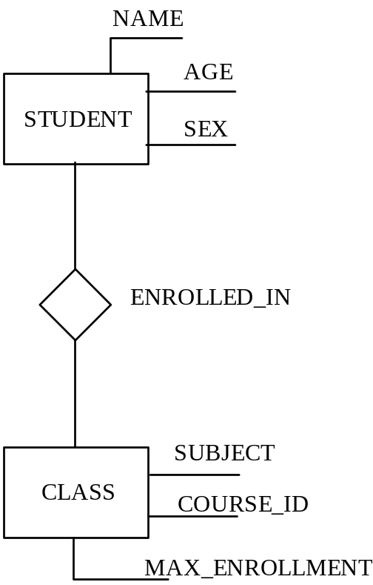
An ER diagram describing a relationship between students and classes.
Made by Lecturer Navraj Koirala, CCT College, Butwal

